Slide 1


www.cambridge.edu.in
Subject Code:21AIMP67
Project Name:
Digital Voting System
Presented By :
Chethan Swamy N S 1CD21AI008
Ebin M S 1CD21AI062
Department of Artificial Intelligence and Machine Learning

Slide 2
Abstract
In today’s scenario, voters have to go to the polling booth to vote which takes time and the voting percentage is also low due to some voters do not go to polling booth to cast the vote. Digital voting would be helpful as voter can vote online from their computer or laptop or smartphone which can save time of voter, it will be also helpful to increase the voting percentage. Digital voting has admin login which will be handled by election commission and voter login which will be handled by voter. Voters can login through their voter ID number and password after a successful registration. The system will allows voters to view a list of candidates in their area, voters can get to know the candidates background (like income, works, etc.) and choose wisely. Once the election is started voter have to login into the account, select a candidate and have to give face id with webcam or front camera, if the face matches with the face given at the time of registration then voter will be promoted for two factor authentication, if two factor authentication is successful then the vote will be submitted and one voter can vote for a candidate only once per election.
Department of Artificial Intelligence and Machine Learning www.Cambridge.edu.in

Slide 3
Introduction
An online voting system is a software platform that enables voters to cast their votes electronically from any location via the internet, typically using a computer, smartphone, or other digital devices.
It will have admin login and voter login. Admin login will be handled by election commission. Voter have to register one time by the unique voter identification number and can set a password for login and have to give face id with use of webcam or front camera
Voter can then login by unique voter identification number and password. For security purpose, at the time of voting the voter have to give face id, if face matches with the face given at the time of registration then the voter will be promoted for two factor authentication.
In two factor authentication, voter have to give the mobile one time password which is sent to the voter’s registered mobile number, if mobile one time password verification successful then voter have to give email one time password which is sent to the voter’s registered email address, if the email one time password verification is successful then the vote will be submitted.
Department of Artificial Intelligence and Machine Learning www.Cambridge.edu.in

Slide 4
Problem Statement
" Create an online voting system that is secure, easy to use and ensures that only eligible people can cast their votes and stay private"
Department of Artificial Intelligence and Machine Learning www.Cambridge.edu.in

Slide 5
OBJECTIVES
Secure Voter Authentication: Ensure that only eligible voters can access the system and cast their votes.
Vote Privacy: Protect the confidentiality of each voter's choices.
Data Integrity: Safeguard the accuracy and integrity of all voting data.
User-Friendly Interface: Design an intuitive and easy-to-use platform for all voters.
Accessibility: Make the system accessible to people with disabilities and those with limited technology access.
Transparency: Provide clear and verifiable processes to build and maintain trust in the system.
Scalability: Ensure the system can handle a large number of voters without performance issues.
Legal Compliance: Adhere to all relevant laws and regulations governing elections and data protection.
Auditability: Enable independent verification of the election process and results.
Department of Artificial Intelligence and Machine Learning www.Cambridge.edu.in

Slide 6
Literature Survey
SL NO | PAPER TITLE | JOURNAL NAME | DESCRIPTION | PROS | CONS
1 | DIGITAL VOTING | IEEEXPLORE.IEEE.ORG | This survey helped us to know the path or the steps that have to be followed during developing a model for the online voting system .This Source have given a brief description about the flow of the project during the execution | System Preparation Voter Registration Pre-Election Setup Voting Process Vote Counting and Results | Technical Issues Trust and Transparency
2 | Trust and Transparency | IEEEXPLORE.IEEE.ORG | This paper focuses on a system where the user can vote remotely from anywhere using his/her computer or mobile phone and doesn't require the voter to got to the polling station through two step authentication of face recognition and OTP system. This project also allows the user to vote offline as well if he/she feels that is comfortable. The face scanning system is used to record the voters face prior to the election and is useful at the time of voting. The offline voting system is improvised with the help of RFID tags instead of voter id | Self learning models using reward system. Works on both labeled and unlabeled data. Real-Life Applicability | Legal and Regulatory Challenges. Lack of Physical Verification Job loss
Department of Artificial Intelligence and Machine Learning www.Cambridge.edu.in

Slide 7
Methodology
start
Login
valid
NO
Add Edit/view voter
Add Edit/View Candidate
Generate Election
ECM Voting
Complete Election
Generate Result
View Result
View/ Reply complain
Logout
End
Department of Artificial Intelligence and Machine Learning www.Cambridge.edu.in

Slide 8
System Architecture
Start
YES
New User
NO
Register
Login
Face ID
YES
Valid
NO
View Candidate
Select Candidate
Face ID
Valid
NO
Submit vote
View Result
Complain
Logout
End
Department of Artificial Intelligence and Machine Learning www.Cambridge.edu.in

Slide 9
Tools And Technology
Django==4.2.7:Django is a high-level Python web framework that encourages rapid development
requests==2.31.0: This is a popular Python library for making HTTP requests. It abstracts the complexities of making requests behind a simple API, allowing you to send HTTP requests with minimal code.
Pillow==10.1.0:Pillow is a popular Python Imaging Library (PIL) that adds image processing capabilities to your Python interpreter. It's widely used for opening, manipulating, and saving many different image file formats.
opencv-contrib-python==4.8.1.78:OpenCV (Open Source Computer Vision Library) is an open-source computer vision and machine learning software library. It contains more than 2500 optimized algorithms for various computer vision and machine learning tasks.
psycopg2==2.9.9: This is the most popular PostgreSQL adapter for Python, and it allows Python code to interact with PostgreSQL databases in a efficient way.
Department of Artificial Intelligence and Machine Learning www.Cambridge.edu.in

Slide 10
Implementation
Install Django and psycopg2 for PostgreSQL.
Create a Django Project
In settings.py, set up the PostgreSQL database configuration.
In vote/models.py, define the models for the voting system.
In vote/views.py, create views to handle voting and displaying results.
Create HTML templates for voting and results.
In voting_system/urls.py, include the vote app URLs.
Run migrations and create a superuser to access the admin interface.
In vote/admin.py, register your models.
un the Development Server
Department of Artificial Intelligence and Machine Learning www.Cambridge.edu.in

Slide 11
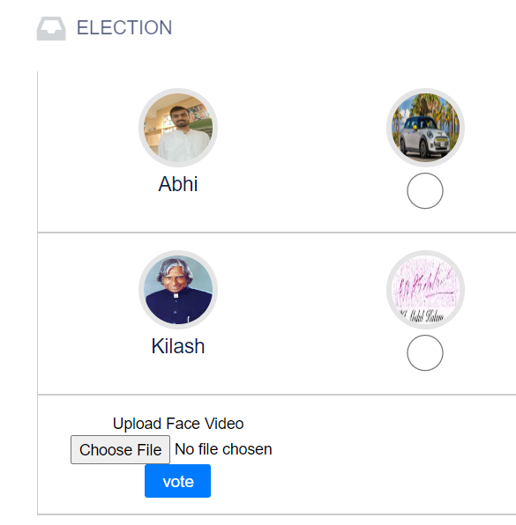
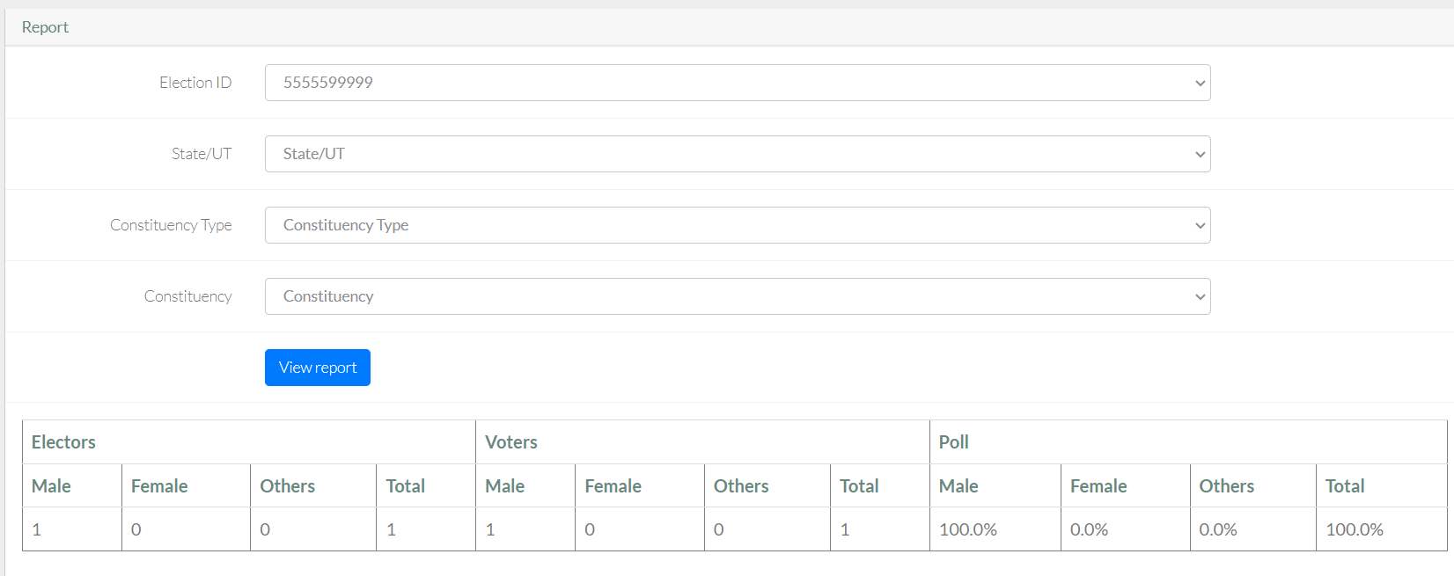
Result
Department of Artificial Intelligence and Machine Learning www.Cambridge.edu.in

Slide 12
Conclusion
Online voting systems offer increased accessibility and efficiency, making it easier for a broader range of voters to participate. They also provide cost savings and faster results compared to traditional methods. These model provides strong security protocols, ensuring system reliability, and designing inclusive solutions that accommodate all voters, while maintaining transparency and public trust in the electoral process.
Department of Artificial Intelligence and Machine Learning www.Cambridge.edu.in

Slide 13
Future Work
Enhanced Security and Privacy : Implement advanced cryptographic techniques and biometric authentication to ensure vote security and voter privacy.
Increased Accessibility : Develop technologies and infrastructure to make online voting accessible to all, including those in remote areas and individuals with disabilities.
Public Trust and Transparency : Ensure transparent voting processes through open-source software, independent audits, and public education to build trust.
Scalability and Reliability : Create robust and scalable infrastructure capable of handling large-scale elections with disaster recovery plans.
Legal and Regulatory Frameworks : Develop international standards and certification processes to ensure compliance and consistency across different jurisdictions.
Department of Artificial Intelligence and Machine Learning www.Cambridge.edu.in

Slide 14
Reference
Meelis Kitsing . Online Participation in Estonia: Active Voting, Low Engagement, 2011.
2 . Micha Germann , Flurin Conradin, Christoph Wellig, Uwe Serdül. Five years of internet voting for Swiss expatriates, 2014.
3. Joseph .D. Enoch, Nne .R. Saturday. Biometric online voting system in Nigeria, 2017.
Department of Artificial Intelligence and Machine Learning www.Cambridge.edu.in

Slide 15
THANK YOU
Department of Artificial Intelligence and Machine Learning www.Cambridge.edu.in

